Slide 1
Read pages 28 – 30 (before “Weighted Graphs”) in the textbook before moving on to the next slide.
  Graphs are an important data structure in Computer Science.
  We will cover many different graph algorithms for the entire semester.
1

Slide 2
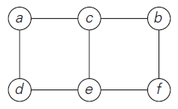
Graph Definition (1 of 2)
Formally, a graph G = <V,E> is defined by a pair of two sets: a finite nonempty set V of items called vertices and a set E of pairs of these items called edges.
Example: Undirected graph
  It has six vertices and seven undirected edges:
  V = {a, b, c, d, e, f }
  E = {(a, c), (a, d), (b, c), (b, f ), (c, e), (d, e), (e, f )}

Slide 3
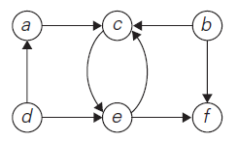
Graph Definition (2 of 2)
Example: Directed graph (or Digraph)
  It has six vertices and eight directed edges:
  V = {a, b, c, d, e, f }
  E = {(a, c), (b, c), (b, f ), (c, e), (d, a), (d, e), (e, c), (e, f )}

Slide 4
Question
Are the figure (i) and (ii) graphs?
a
a
b
c
b
c
(i)
(ii)

Slide 5
Answer
Both are graphs.
  Figure (i) has three vertices and two undirected edges:
  V = {a, b, c }
  E = {(a, b), (a, c)}
  Figure (ii) has three vertices and zero edges:
  V = {a, b, c }
  E = { }

Slide 6
Question
How about the figure (iii), (iv), and (v)?
  Are they graphs?
a
a
a
b
c
a
c
b
c
(iii)
(iv)
(v)

Slide 7
Answer
Figure (v) is a graph. But figure (iii) and (iv) are not graphs.
  Figure (iii) has duplicated edges:
  E = {(a, b), (a, b), (a, c)}
  Figure (iv) has duplicated vertices:
  V = {a, a, c }
  Since V and E are sets in the graph definition, they can’t have duplication.
  However, figure (v) is fine because the edge (a, b) and (b, a) indicate different edges in the directed graph.

Slide 8
Important Note
Conventionally, we enumerate a set’s elements using a non-decreasing order.
  For example, in the digraph on slide number 12, the sets V and E are shown as follows:
  V = {a, b, c, d, e, f }
  E = {(a, c), (b, c), (b, f ), (c, e), (d, a), (d, e), (e, c), (e, f )}
  When expressing these sets, the sequence is not important. However, we enumerate the elements in alphabetical order (from a to z) in this class.
  You must always follow this convention when you are doing homework or at exams.

Slide 9

Remaining Topics in the Graph
Study the textbook to understand the following formula:
Also, understand the following terms:
  Complete graph
  Dense graph
  Sparse graph

Slide 10
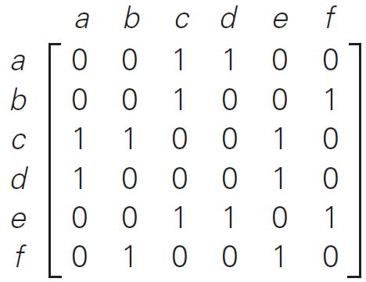
Graph Representation: Adjacency matrix
Example
Graph
Adjacency Matrix

Slide 11
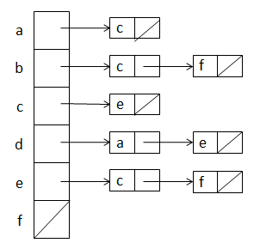
Graph Representation: Adjacency list
Example
Graph
Adjacency List

Slide 12
Exercise
Represent the following graph in adjacency matrix and adjacency list.
  Again, do not see the answer immediately. Try to solve it first.
a
b
c

Slide 13
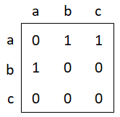
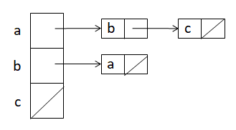
Solution
Adjacency Matrix
Adjacency List

